Slide 1



Geologist
Authors:
Kristina Zheltova, SibSU
Sofia Burmistrova, ITMO University
Mentor:
Petr Andriushchenko, ITMO University

Slide 2
Plan
Task description
Data understanding
Anomaly detection
Data generation
Filling missing values

Slide 3
Tasks
Filling in missing values:
Porosity is the percentage of voids and open spaces in a rock [1].
Tectonic regime is characteristic of processes that control the structure and properties of the Earth's crust and its evolution through time.
Assess the reliability of parameter values (anomaly detection).
Generate oil deposit synthetic data.
[1] Mohammad Ali Ahmadi, Zhangxing Chen (2019), “Comparison of machine learning methods for estimating permeability and porosity of oil reservoirs via petro-physical logs”

Slide 4
Why these tasks are important?
Incomplete data
Fill missing values
Not enough data
Generate new data
Enough data
Verify the data

Slide 5
Review on existing solutions
Wei Chen, Liuqing Yang “Deep learning reservoir porosity prediction based on multilayer long short-term memory network”
Mohammad Ali Ahmadi, Zhangxing Chen “Comparison of machine learning methods for estimating permeability and porosity of oil reservoirs via petro-physical logs”
Fatai Adesina Anifowose “Prediction of Porosity and Permeability of Oil and Gas Reservoirs using Hybrid Computational Intelligence Models”

Slide 6
Data understanding

Slide 7
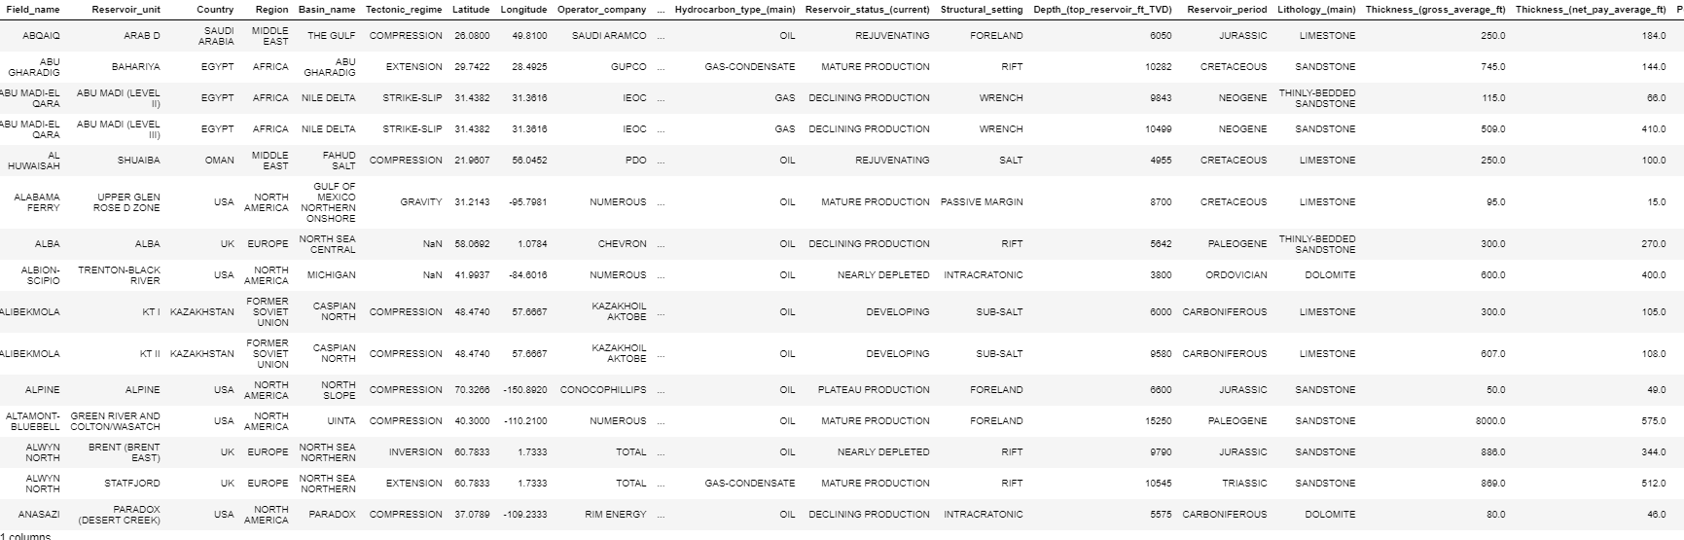
Dataset
The dataset consists of 20 different categorical and continuous parameters of 513 oil deposit.
There are 72 blanks in one categorical and one continuous parameter.
Fig. 1 – source dataset.

Slide 8
Groups within data
Reservoirs characteristics
Depth
Thickness (gross/net pay)
Reservoir status
Reservoir period
Operator company
Reservoir unit
Hydrocarbon type
Field name
Geographic characteristics
Country, region
Latitude, Longitude
Onshore/Offshore
Basin name
Rock’s characteristics
Lithology
Porosity
Permeability
Tectonic regime
Structural setting
Unique features
N

Slide 9
Type of features
Categorical
Field name
Reservoir unit
Country
Region
Basin name
Tectonic regime
Operator company
Onshore or offshore
Hydrocarbon type (main)
Reservoir status (current)
Structural setting
Reservoir period
Lithology (main)
Numerical
N
Depth (top reservoir ft TVD)
Thickness (gross average ft)
Thickness (net pay average ft)
Porosity (matrix average %)
Permeability (air average mD)
Latitude
Longitude

Slide 10
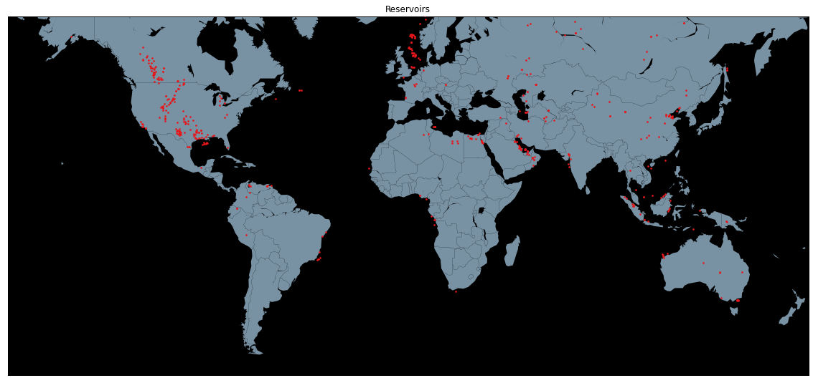
Geospatial visualization of the dataset
Fig. 2 – visualization of geospatial data.

Slide 11
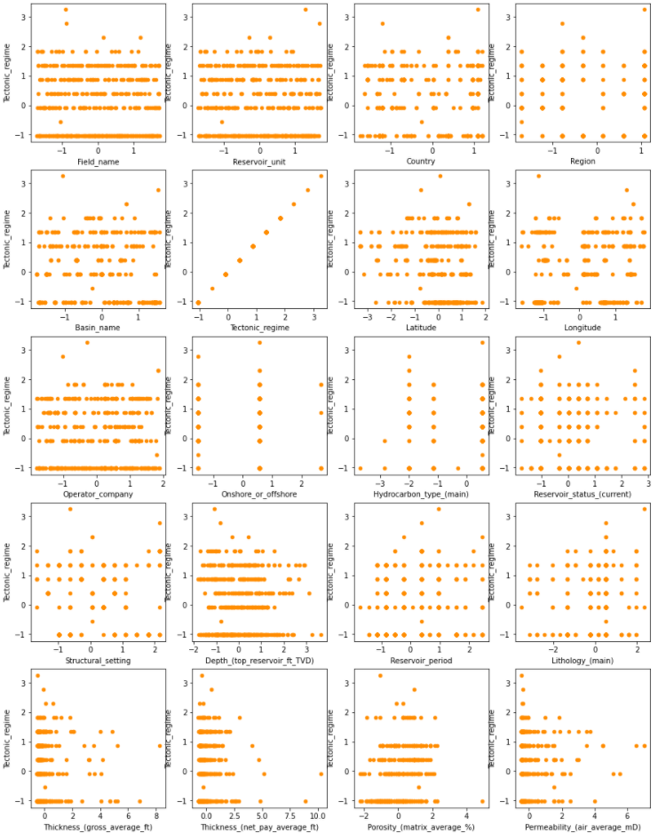
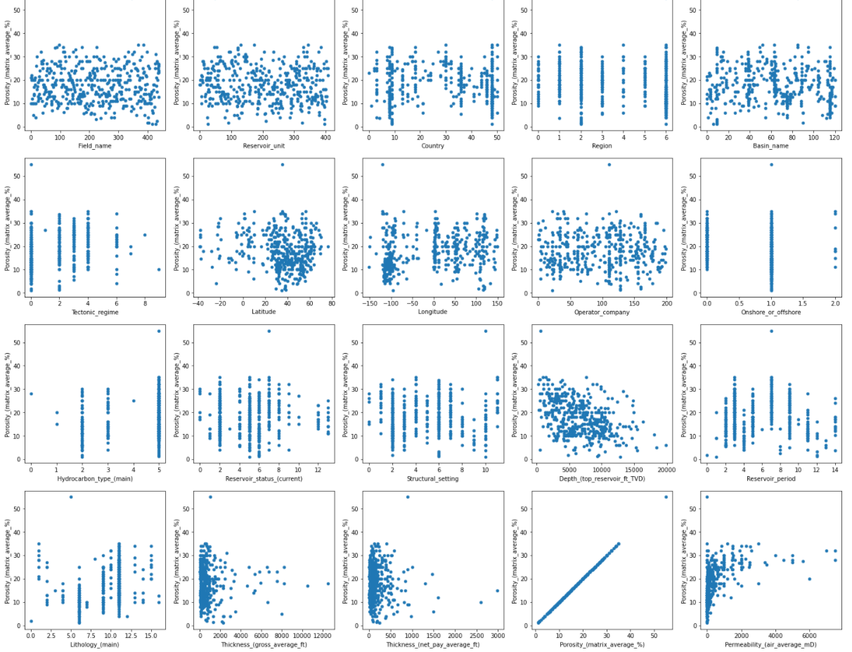
Distributions by target features
Fig. 3 – pairwise scatterplots with porosity feature.
Fig. 4 – pairwise scatterplots with tectonic regime feature.

Slide 12
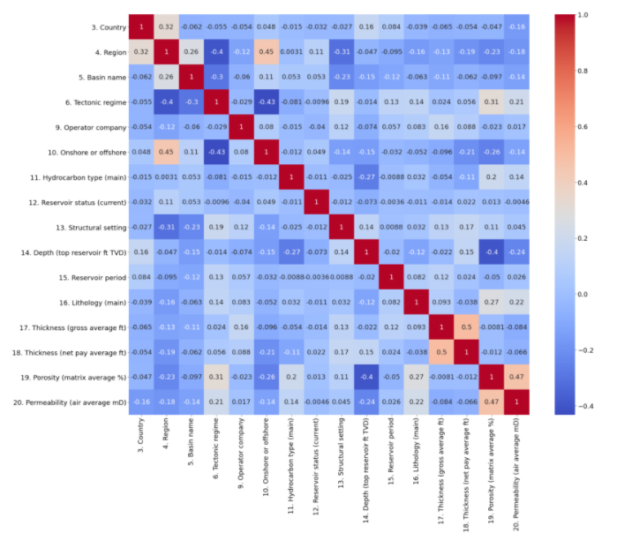
Try to find a correlation
Fig. 5 – heatmap of features correlation.

Slide 13
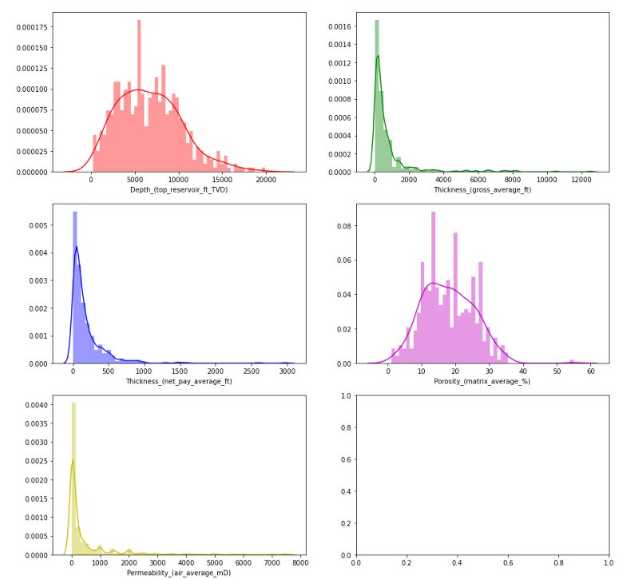
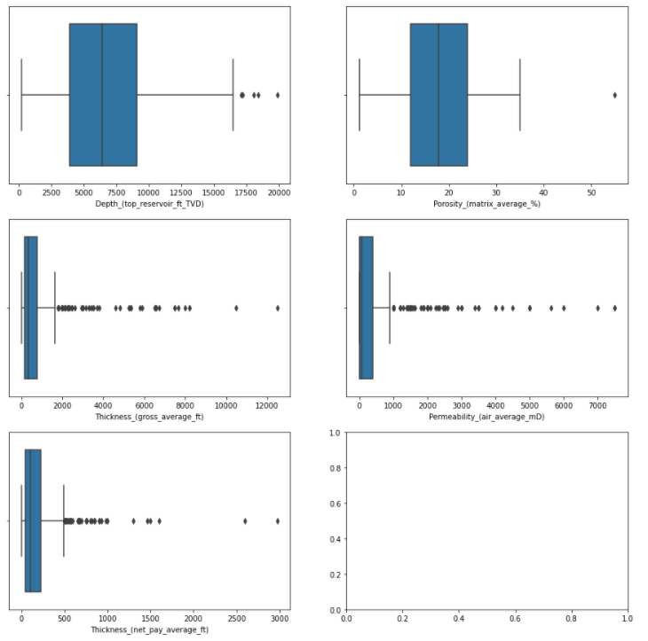
Outliers in numerical features
Fig. 6 – distribution plots of numerical features.
Fig. 7 – boxplots of numerical features.

Slide 14
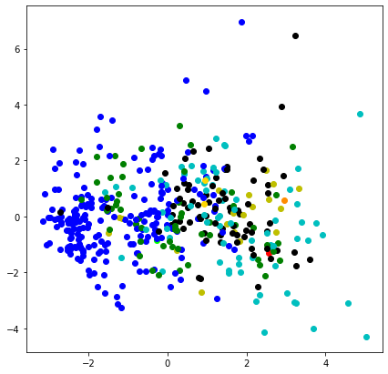
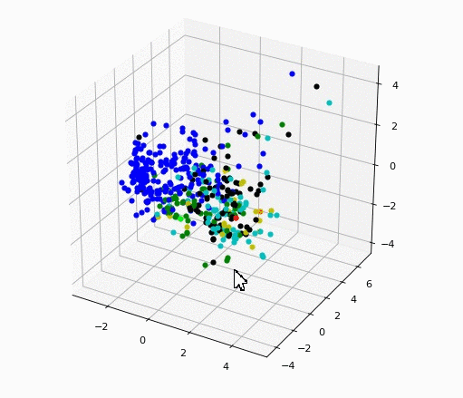
PCA with coloring by tectonic regime
Fig. 8 – 2D PCA with coloring by tectonic regime.
Fig. 9 – 3D PCA with coloring by tectonic regime.

Slide 15
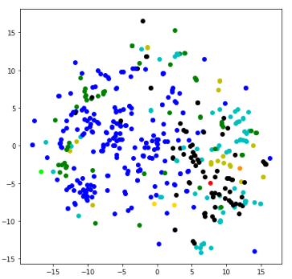
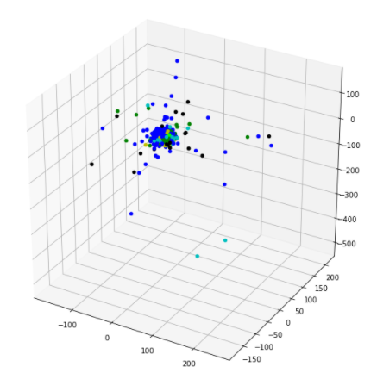
t-SNE with coloring by tectonic regime
Fig. 10 – 2D t-SNE with coloring by tectonic regime.
Fig. 11 – 3D t-SNE with coloring by tectonic regime.
More on t-SNE and PCA comparison: https://www.geeksforgeeks.org/difference-between-pca-vs-t-sne

Slide 16
Anomaly detection

Slide 17
Anomaly
Outliers
Novelty

Slide 18
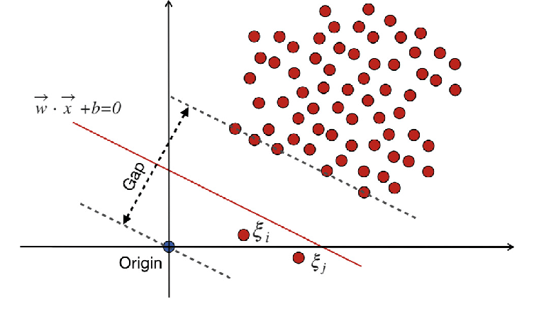
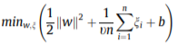
One-class SVM
SVM attempts to identify the hyperplane that best represents the largest separation, or margin, between border-line data points (i.e., ‘‘support vectors”).
One-class SVM creates a finds the maximal gap hyperplane that separates data from the origin.
The resulting closed boundary is found using the following formulation [2]
Fig. 12 – overview of one-class Support Vector Machine (SVM).
[2] Bonsang Koo, Byungjin Shin “Applying novelty detection to identify model element to IFC class misclassifications on architectural and infrastructure Building Information Models”
More on one-class SVM hyperparameter tuning: http://activisiongamescience.github.io/2015/12/23/Unsupervised-Anomaly-Detection-SOD-vs-One-class-SVM

Slide 19
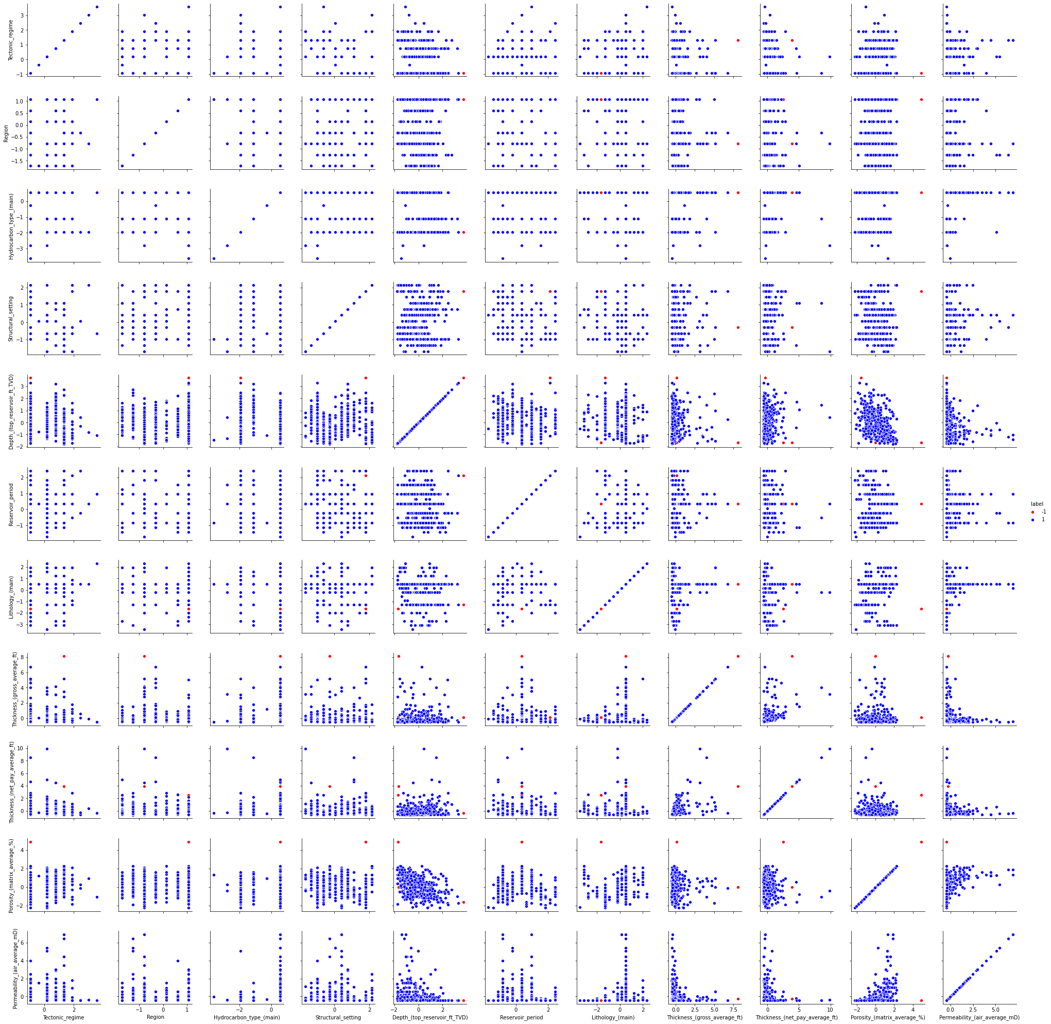
Applying SVM to existing dataset
Selected columns to fit the model:
Tectonic regime
Region
Hydrocarbon type (main)
Structural setting
Depth (top reservoir ft TVD)
Reservoir period
Lithology (main)
Thickness (gross average ft),
Thickness (net pay average ft)
Porosity (matrix average %)
Permeability (air average mD)
We can plot 11x11 scatterplot in order to visualize anomalies within pairwise distributions.
Fig. 13 – pairwise scatterplots with colored anomalies.

Slide 20
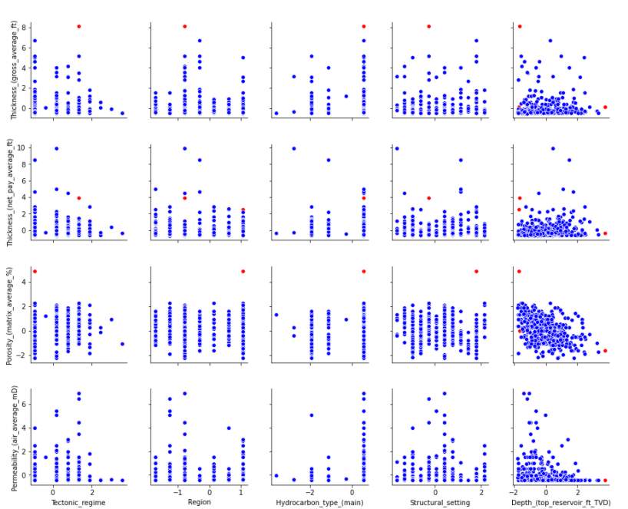
Applying SVM to existing dataset
Some plots don’t contain anomaly points.
Very often relatively distant points are considered as anomalies.
Valid samples percent = 99.32…
Anomalies percent = 0.67…
Fig. 14 – particular pairwise scatterplots with colored anomalies.

Slide 21
Manual data with anomalies
Take N valid objects from source data sets.
Randomly change numeric features to extreme values.
Fig. 15 – boxplots of numerical features.

Slide 22
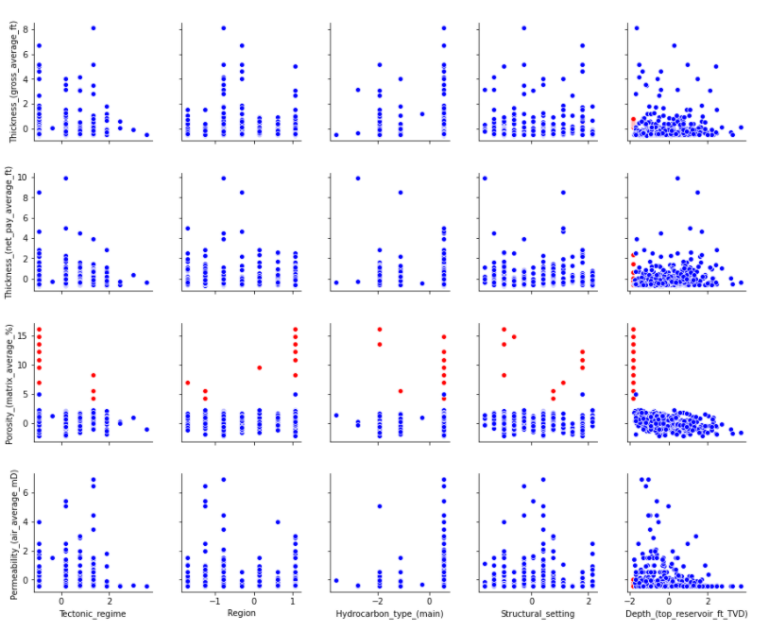
Manual data with anomalies
All generated data were considered anomalies.
Of course these samples were simple and maybe obvious for the model.
Fig. 16 – particular pairwise scatterplots with manually added anomalies.

Slide 23
Data generation

Slide 24
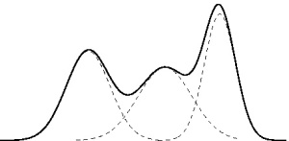
Gaussian mixture model
A Gaussian Mixture Model (GMM) is a parametric probability density function represented as a weighted sum of Gaussian component densities [3].
Fig. 17 – Gaussian mixture model.
.
[3] “Gaussian Mixture Models” https://prateekvjoshi.com/2013/06/29/gaussian-mixture-models/

Slide 25
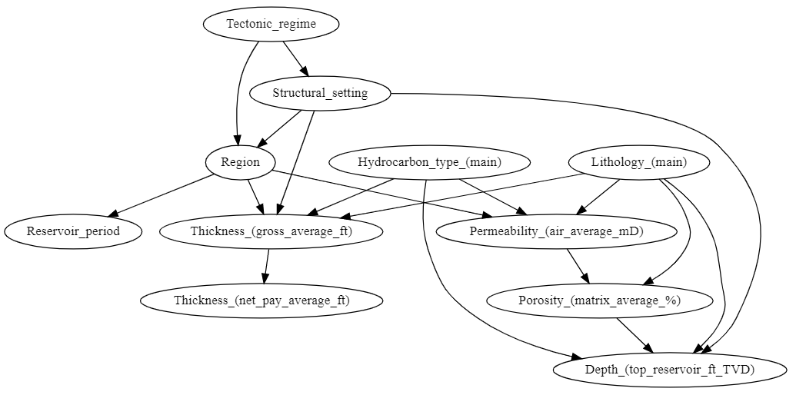
Bayesian networks model
A Bayesian network (BN) is a compact representation of a probability distribution over a set of discrete variables. The structure of a BN is a directed acyclic graph (DAG), where the arcs have a formal interpretation in terms of probabilistic conditional independence [4].
Fig. 18 – Example of a network’s DAG with k2 score.
.
[4] Concha Bielza, Pedro Larrañaga (2014) “Bayesian networks in neuroscience: a survey”

Slide 26
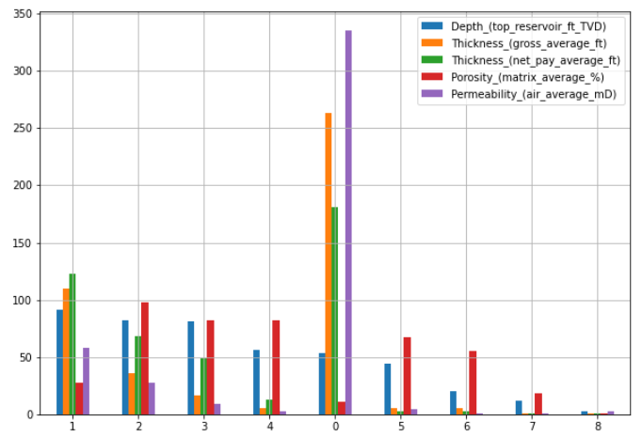
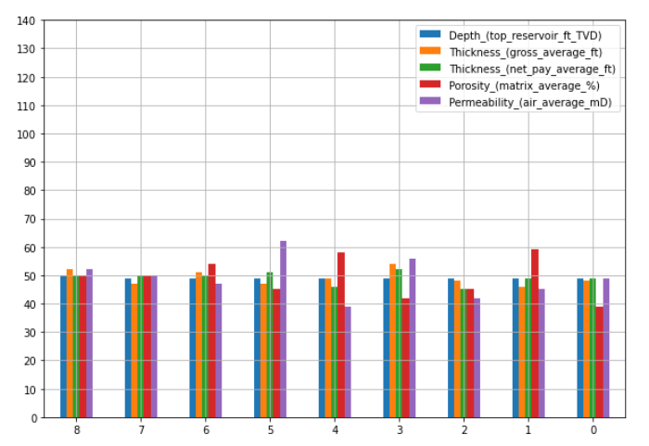
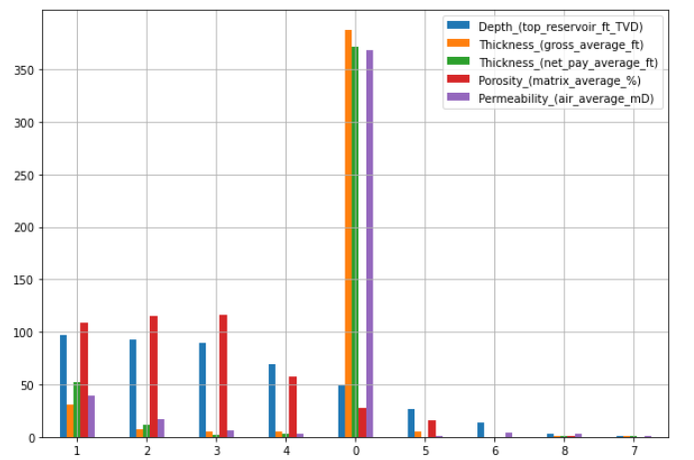
Discretization strategy
Fig. 20 – kmeans strategy.
Fig. 19 – quantile strategy.
Fig. 21 – uniform strategy.

Slide 27
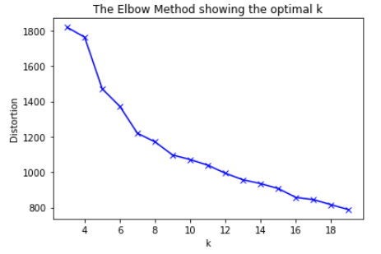
n_bins in KBinsDiscretizer
Fig. 22 – k-means for all columns.
Fig. 23 – k-means for each column.

Slide 28
Different BN scores
There are 2 most popular scoring functions:
K2
BDeu
To obtain the BDeu score, we need a parameter called equivalent sample size α that expresses the strength of our prior belief in the uniformity of the conditional distributions of the network. A quick look at the Bayesian network learning literature reveals that there is no generally accepted “uninformative” value for the α parameter [5].
[5] Tomi Silander, Petri Kontkanen, Petri Myllymaki (2007) “On Sensitivity of the MAP Bayesian Network Structure to the Equivalent Sample Size Parameter”

Slide 29
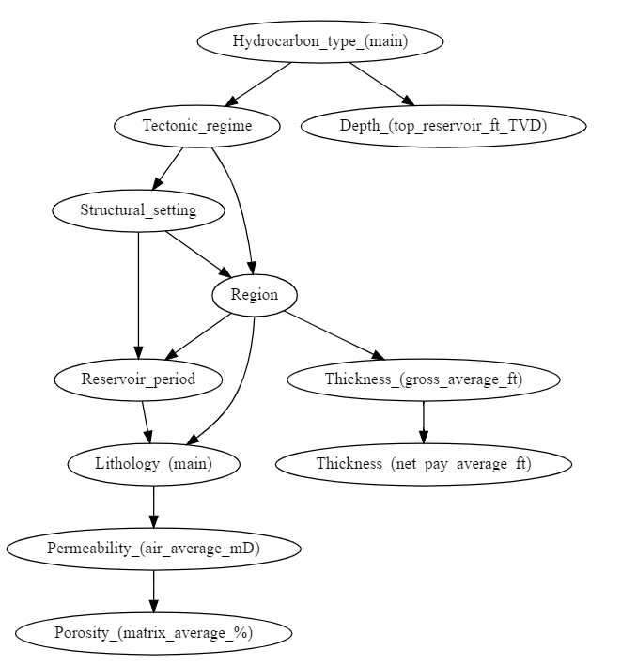
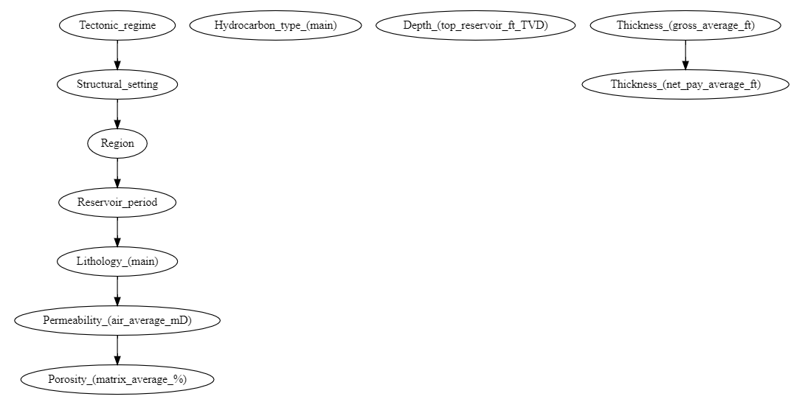
BDeu hyperparameter search
Equivalent sample size significantly (ESS) impacts on the DAG structure
We performed exhaustive search in range [20, 100]
Fig. 24 – DAG for bn with BDeu score and ESS = 78.
Fig. 25 – DAG for bn with BDeu score and ESS = 10.

Slide 30
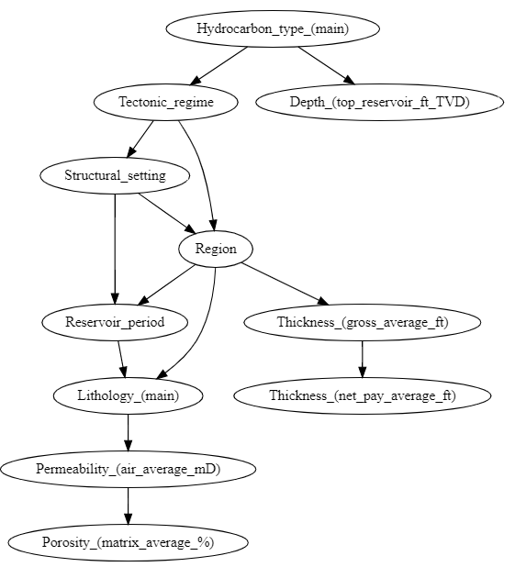
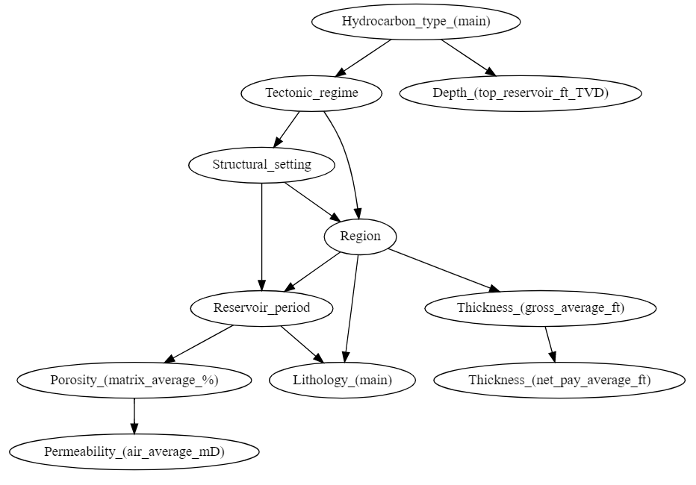
Comparison of BN graphs
Fig. 26 – DAG for bn with BDeu score and single discretizer.
Fig. 27 – DAG for bn with BDeu score and several discretizers.

Slide 31
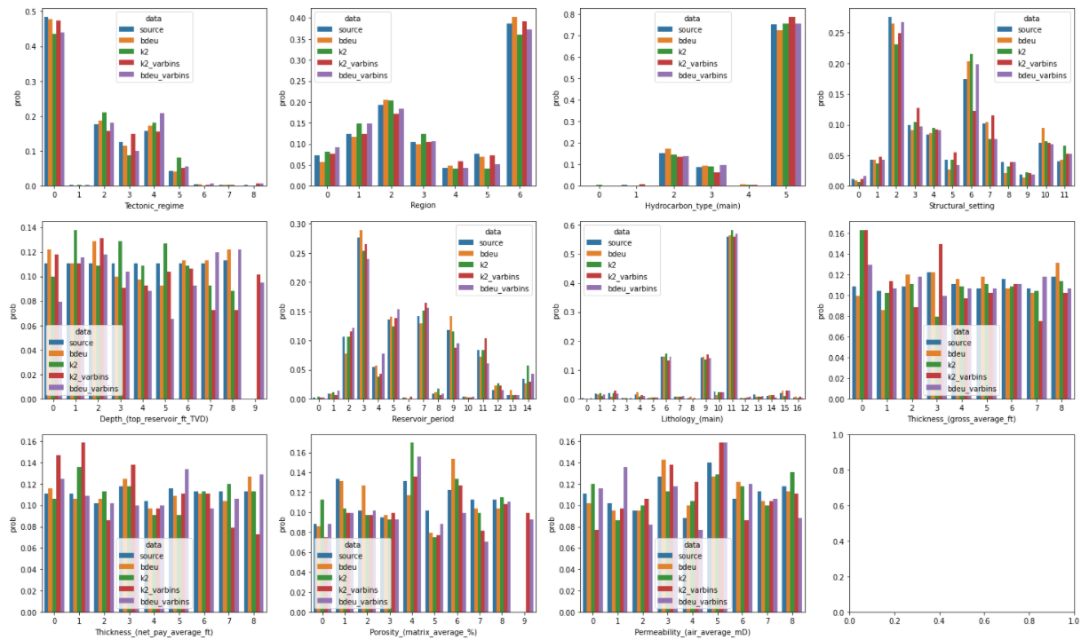
Comparison of BN models performances
Fig. 28 – Histograms of one-feature distributions.

Slide 32
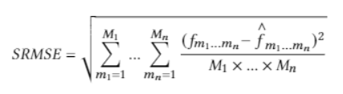
SRMSE
SRMSE metric allows to measure error of joint distributions.
Selected sets:
The set of categorical features
The set of numerical features
The set of correlated features (porosity and permeability)
As a result the model with BDeu score has a little better metric value, then the model with k2 score.

Slide 33
Data sampling pipeline
Sample new data with BN
Apply inverse transformation of LabelEncoder
Apply inverse transformation of kBinsDicretizer
Fig. 29 – samples from the model with BDeu score.
Fig. 29 – samples from the model with k2 score.

Slide 34
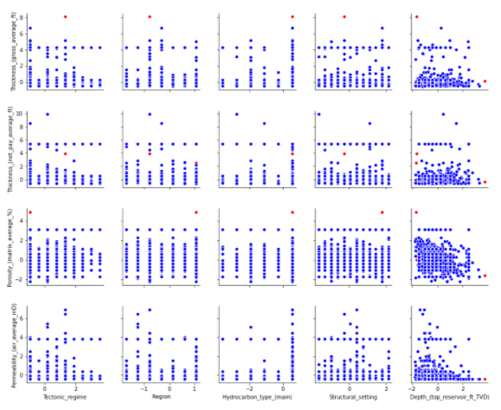
Applying SVM to generated samples
0.9979
0.9979
10000 generated samples
BDeu valid samples percentage = 99.79
k2 valid samples percentage = 99.6
Fig. 30 – particular pairwise scatterplots with anomalies in sampled data.

Slide 35
Filling missing values

Slide 36
Prediction models
For categorical missing values | For numerical missing values
RandomForestClassifier | RandomForestRegressor
GradientBoostingClassifier | GradientBoostingRegressor
ExtraTreesClassifier | ExtraTreesRegressor
AdaBoostClassifier | AdaBoostRegressor
XGBClassifier | XGBRegressor
Bayesian network | Ridge regression
Metrics
Accuracy, F1-score
RMSE

Slide 37
Data and Parameters
For data preparation:
Label encoding
Scaler
Normaliser
For models:
Нyper-parameters tuning
Cross-validation
Important features

Slide 38
Comparison of applied models
Validation score for categorical value
 | RF Classifier | GB Classifier | ExtraTrees Classifier | XGB Classifier | AdaBoost Classifier
Accuracy | 0.9101 | 0.9101 | 0.9213 | 0.8989 | 0.5730
F1 | 0.9087 | 0.9113 | 0.9192 | 0.8978 | 0.4497
Validation RMSE score for numerical value
RF Regressor | GB Regressor | ExtraTrees Regressor | AdaBoost Regressor | XGB Regressor | Ridge
4.8994 | 5.3328 | 4.2872 | 5.1466 | 5.2331 | 5.2172

Slide 39
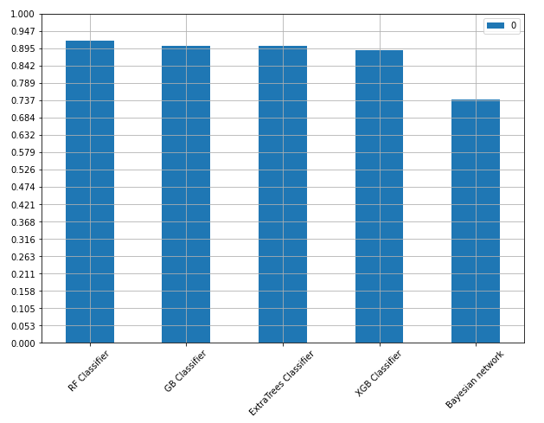
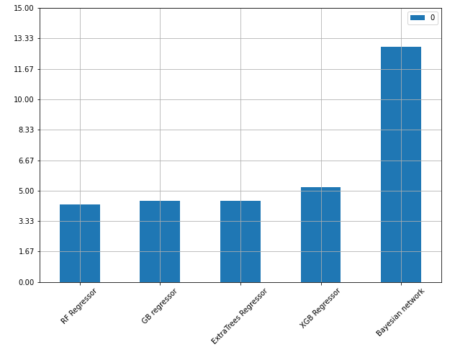
Test score
Fig. 31 – test score for the classification task.
Fig. 32 – test score for the regression task.

Slide 40
Comparison of applied models
Test score for categorical value
 | RF Classifier | GB Classifier | ExtraTrees Classifier | XGB Classifier | Bayesian network
Accuracy | 0.9166 | 0.9030 | 0.9025 | 0.8899 | 0.75
Test RMSE score for numerical value
RF Regressor | GB Regressor | ExtraTrees Regressor | XGB Regressor | Bayesian network
4.2242 | 4.4254 | 4.4409 | 5.2029 | 12.8659

Slide 41

Thank you for your attention!

